Slide 1
Chapter 16: Graphics

Slide 2
Objectives
Learn about rendering methods
Draw strings
Draw lines and shapes
Learn more about fonts
Draw with Java 2D graphics
Java Programming, Eighth Edition

Slide 3
Learning About Rendering Methods
Render
  To redisplay a display surface
Painting
  System-triggered painting
  Application-triggered painting
paint() method
  Write your own method to override the default
  Method header
    public void paint(Graphics g)
Java Programming, Eighth Edition

Slide 4
Learning About Rendering Methods (cont’d.)
Graphics object
  Preconfigured with the appropriate values for drawing on the component
repaint() method
  Use when a window needs to be updated
  Calls the paintComponent() method
  Creates a Graphics object
Java Programming, Eighth Edition

Slide 5
Learning About Rendering Methods (cont’d.)
When Swing object calls repaint() these methods are called:
  paint(), paintComponent(), paintBorder(), paintChildren()
Place all drawing code in paintComponent() method
    Public void paintComponent (Graphics g);
  Typical first statement
    Super.paintComponent(g);
Java Programming, Eighth Edition

Slide 6
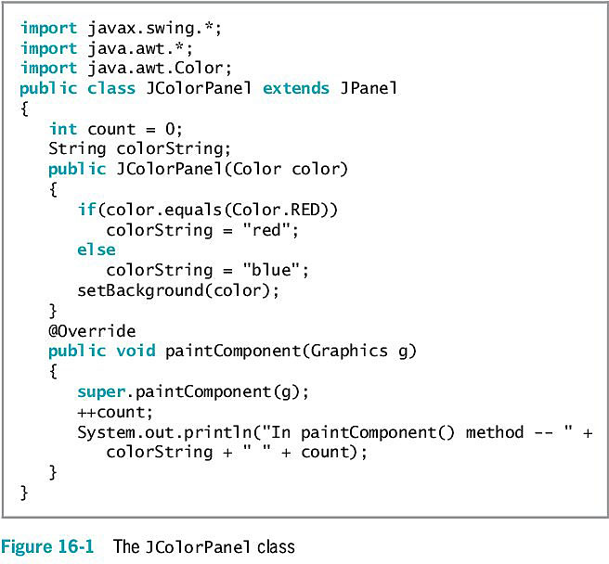
Learning About Rendering Methods (cont’d.)
Java Programming, Eighth Edition

Slide 7
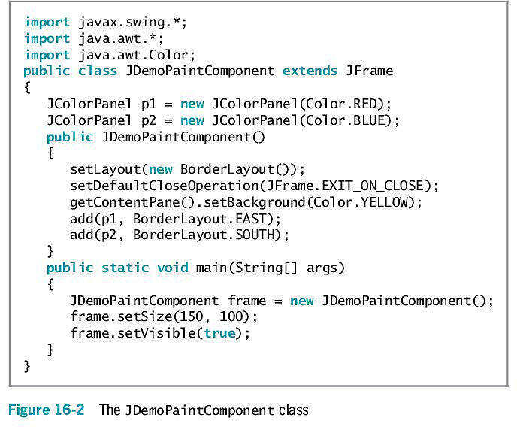
Learning About Rendering Methods (cont’d.)
Java Programming, Eighth Edition

Slide 8
Drawing Strings
drawString() method
  Allows you to draw a String in a JFrame window
  Requires three arguments:
    String
    x-axis coordinate
    y-axis coordinate
  Is a member of the Graphics class
  Repainting: Can execute paintComponent() even when no draw-triggering changes have been made
Java Programming, Eighth Edition

Slide 9
Setting A Font
setFont() method
  Requires a Font object
You can instruct a Graphics object to use a font
  somegraphicsobject.setFont(someFont);
Java Programming, Eighth Edition

Slide 10
Using Color
setColor() method
  Designates a Graphics color
  Use 13 Color class constants as arguments
    brush.setColor(Color.GREEN);
Java Programming, Eighth Edition

Slide 11
Drawing Lines and Shapes
Java provides several methods for drawing a variety of lines and geometric shapes
Java Programming, Eighth Edition

Slide 12
Drawing Lines
drawLine() method
  Draws a straight line between any two points
  Takes four arguments:
    x- and y-coordinates of the line’s starting point
    x- and y-coordinates of the line’s ending point
Java Programming, Eighth Edition

Slide 13
Drawing Unfilled and Filled Rectangles
drawRect() method
  Draws the outline of a rectangle
fillRect() method
  Draws a solid or filled rectangle
Both require four arguments:
  x- and y-coordinates of the upper-left corner of the rectangle
  The width and height of the rectangle
Java Programming, Eighth Edition

Slide 14
Drawing Clear Rectangles
clearRect() method
  Draws a rectangle
  Requires four arguments:
    x- and y-coordinates of the upper-left corner of the rectangle
    The width and height of the rectangle
  Appears empty or “clear”
Java Programming, Eighth Edition

Slide 15
Drawing Rounded Rectangles
drawRoundRect() method
  Creates rectangles with rounded corners
  Requires six arguments
fillRoundRect()method
Java Programming, Eighth Edition

Slide 16
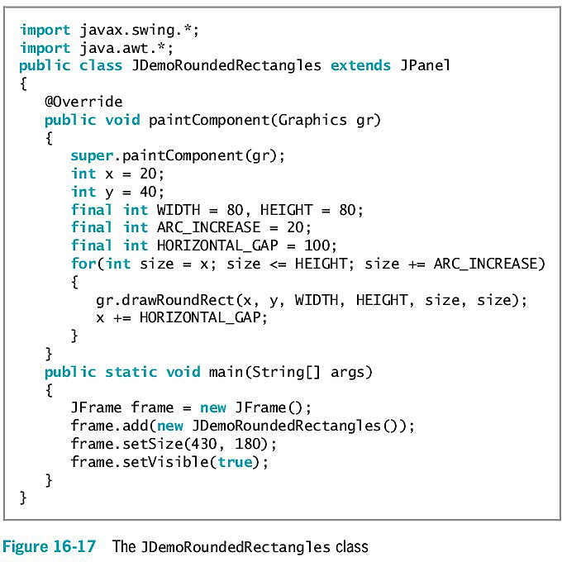
Drawing Rounded Rectangles (cont’d.)
Java Programming, Eighth Edition

Slide 17
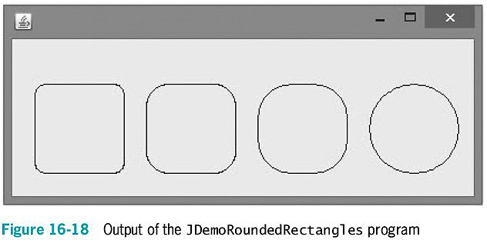
Drawing Rounded Rectangles (cont’d.)
Java Programming, Eighth Edition

Slide 18
Creating Shadowed Rectangles
draw3DRect() method
  A minor variation on the drawRect() method
  Draws a rectangle that appears to have “shadowing” on two edges
  Contains a Boolean value argument:
    true if the rectangle is darker on the right and bottom
    false if the rectangle is darker on the left and top
fill3DRect() method
  Creates filled three-dimensional rectangles
Java Programming, Eighth Edition

Slide 19
Drawing Ovals
drawOval() and fillOval() methods
  Draw ovals using the same four arguments that rectangles use
Java Programming, Eighth Edition

Slide 20
Drawing Arcs
drawArc() method arguments
  x- and y-coordinates of the upper-left corner of an imaginary rectangle that represents the bounds of the imaginary circle that contains the arc
  The width and height of the imaginary rectangle that represents the bounds of the imaginary circle that contains the arc
  The beginning arc position
  The arc angle
Java Programming, Eighth Edition

Slide 21
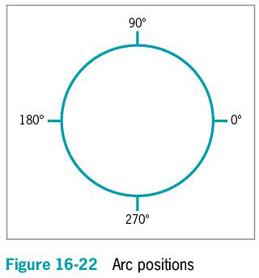
Drawing Arcs (cont’d.)
Java Programming, Eighth Edition

Slide 22
Drawing Arcs (cont’d.)
fillArc() method
  Creates a solid arc
    Two straight lines are drawn from the arc endpoints to the center of the imaginary circle whose perimeter the arc occupies
Java Programming, Eighth Edition

Slide 23
Creating Polygons
Polygon: geometric figure with straight sides
drawPolygon() method
  Draws complex shapes
  Requires three arguments:
    The integer array, which holds a series of x-coordinate positions
    The second array, which holds a series of corresponding
    y-coordinate positions
    The number of pairs of points to connect
Java Programming, Eighth Edition

Slide 24
Creating Polygons (cont’d.)
fillPolygon() method
  Draws a solid shape
  If the beginning and ending points are not identical, two endpoints are connected by a straight line before the polygon is filled with color
addPoint() method
  Adds points to a polygon indefinitely
Java Programming, Eighth Edition

Slide 25
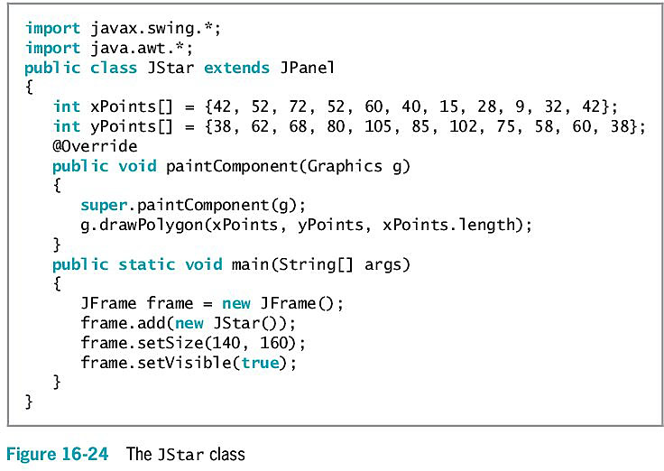
Creating Polygons (cont’d.)
Java Programming, Eighth Edition

Slide 26
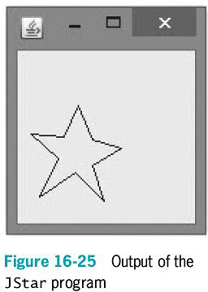
Creating Polygons (cont’d.)
Java Programming, Eighth Edition

Slide 27
Copying an Area
copyArea() method
  Requires six parameters:
    The x- and y-coordinates of the upper-left corner of the area to be copied
    The width and height of the area to be copied
    The horizontal and vertical displacement of the destination of the copy
Java Programming, Eighth Edition

Slide 28
Using the paint Method with JFrames
Use the paintComponent() method when creating drawings on a JPanel
JFrame is not a child of JComponent
  Does not have its own paintComponent() method
  Must override the paint() method
Java Programming, Eighth Edition

Slide 29
Learning More About Fonts
getAvailableFontFamilyNames() method
  Is part of the GraphicsEnvironment class defined in the java.awt package
  Returns an array of String objects that are names of available fonts
You cannot instantiate the GraphicsEnvironment object directly
  Get the reference object to the current computer environment
    Call the static getLocalGraphicsEnvironment() method
Java Programming, Eighth Edition

Slide 30
Discovering Screen Statistics
getDefaultToolkit() method
  Provides information about the system in use
getScreenResolution() method
  Returns the number of pixels as an integer
You can create a Toolkit object and get the screen resolution using the following code:
  Toolkit tk = Toolkit.getDefaultToolkit();
  int resolution = tk.getScreenResolution();
Java Programming, Eighth Edition

Slide 31
Discovering Screen Statistics (cont’d.)
Dimension class
  Use for representing the width and height of a user interface component
  Constructors
    Dimension() creates an instance of Dimension with a width and height of 0
    Dimension(Dimension d) creates an instance of Dimension whose width and height are the same as for the specified dimension
    Dimension(int width, int height) constructs a Dimension and initializes it to the specified width and height
Java Programming, Eighth Edition

Slide 32
Discovering Screen Statistics (cont’d.)
getScreenSize() method
  Is a member of the Toolkit object
  Returns an object of type Dimension, which specifies the width and height of the screen in pixels
Java Programming, Eighth Edition

Slide 33
Discovering Font Statistics
Leading
  The amount of space between baselines
Ascent
  The height of an uppercase character from the baseline to the top of the character
Descent
  Measures the parts of characters that “hang below” the baseline
Height of a font
  The sum of leading, ascent, and descent
Java Programming, Eighth Edition

Slide 34
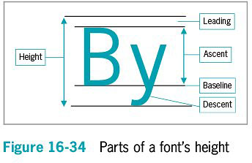
Discovering Font Statistics (cont’d.)
Java Programming, Eighth Edition

Slide 35
Discovering Font Statistics (cont’d.)
getFontMetrics() method
  Discovers a font’s height
  Returns the FontMetrics object
Use one of the FontMetrics class methods with the object to return one of a Font’s statistics:
  public int getLeading()
  public int getAscent()
  public int getDescent()
  public int getHeight()
Java Programming, Eighth Edition

Slide 36
Discovering Font Statistics (cont’d.)
stringWidth() method
  Returns the integer width of a String
  Requires the name of the String
  Is a member of the FontMetrics class
Java Programming, Eighth Edition

Slide 37
Drawing with Java 2D Graphics
Java 2D
  Higher quality, two-dimensional (2D) graphics, images, and text
Graphics2D class
  Features include:
    Fill patterns
    Strokes
    Anti-aliasing
Java Programming, Eighth Edition

Slide 38
Drawing with Java 2D Graphics (cont’d.)
Graphics2D class (cont’d.)
  Found in the java.awt package
  Produced by casting, or converting, and promoting a Graphics object
The process of drawing with Java 2D objects
  Specify the rendering attributes
  Set a drawing stroke
  Create objects to draw
Java Programming, Eighth Edition

Slide 39
Specifying the Rendering Attributes
Use the setColor() method
  Specify 2D colors
  Use a Graphics2D object and set the color to black
    gr2D.setColor(Color.BLACK);
Fill patterns:
  Control how a drawing object is filled in
  Can be a solid, gradient, texture, or pattern
  Created by using the setPaint() method of Graphics2D with a fill pattern object
Java Programming, Eighth Edition

Slide 40
Specifying the Rendering Attributes (cont’d.)
Gradient fill
  A gradual shift from one color at one coordinate point to a different color at a second coordinate point
  Acyclic gradient
  Cyclic gradient
Java Programming, Eighth Edition

Slide 41
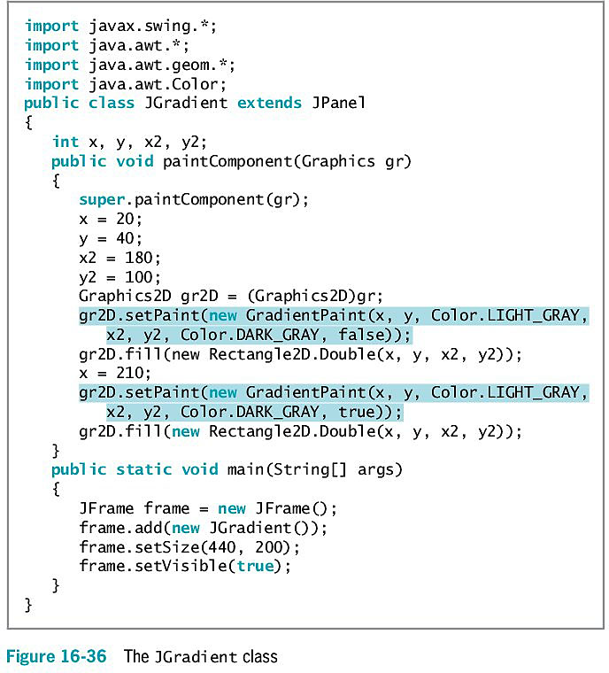
Java Programming, Eighth Edition

Slide 42
Setting a Drawing Stroke
Stroke
  Represents a single movement
  setStroke() method
Stroke interface
BasicStroke class
Endcap styles
  Apply to the ends of lines that do not join with other lines
Juncture styles
  For lines that join
Java Programming, Eighth Edition

Slide 43
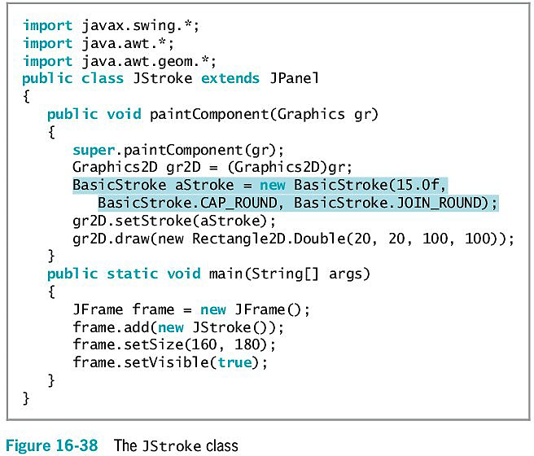
Setting a Drawing Stroke (cont’d.)
Java Programming, Eighth Edition

Slide 44
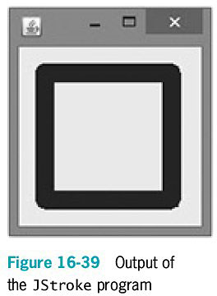
Setting a Drawing Stroke (cont’d.)
Java Programming, Eighth Edition

Slide 45
Creating Objects to Draw
Objects drawn in Java 2D are created by defining them as geometric shapes
  Use the java.awt.geom package classes
  Define the shape
  Use the shape as an argument to the draw() or fill() methods
Lines
Line2D.Float
Line2D.Double
Point2D.Float
Point2D.Double
Java Programming, Eighth Edition

Slide 46
Creating Objects to Draw (cont’d.)
Rectangles
Rectangle2D.Float
Rectangle2D.Double
Rectangle2D.Float rect = new Rectangle2D.Float(10F, 10F, 50F, 40F);
Ovals
Ellipse2D.Float
Ellipse2D.Double
Ellipse2D.Float ell = new Ellipse2D.Float(10F, 73F, 40F, 20F);
Java Programming, Eighth Edition

Slide 47
Creating Objects to Draw (cont’d.)
Arcs
Arc2D.Float
Arc2D.Double
Arc2D.PIE
Arc2D.CHORD
Arc2D.OPEN
Arc2D.Float ac = new Arc2D.Float (10,133,30,33,30,120,Arc2D.PIE);
Java Programming, Eighth Edition

Slide 48
Creating Objects to Draw (cont’d.)
Polygons
Define movements from one point to another
GeneralPath object
GeneralPath pol = new GeneralPath();
moveTo()
lineTo()
closePath()
Java Programming, Eighth Edition

Slide 49
You Do It
Using the drawString() Method
Creating a JFrame to Hold JStringPanel Objects
Creating a JPanel with a JButton and Graphics
Observing the Effect of the super.paintComponent() Call
Copying an Area
Java Programming, Eighth Edition

Slide 50
You Do It (cont’d.)
Using FontMetrics to Compare fonts
Using Drawing Strokes
Working with Shapes
Creating an Interactive Program that Draws Lines
Java Programming, Eighth Edition

Slide 51
Don’t Do It
Don’t forget to call super.paintComponent() as the first statement in the paintComponent() method
Don’t forget that the lower-left corner of a String is placed at the coordinates used when you call drawString()
Don’t forget that the name of the Graphics method that draws rectangles is drawRect() and not drawRectangle()
Java Programming, Eighth Edition

Slide 52
Summary
paint() method
drawString() method
  Draws a String in a JApplet window
Methods for drawing a variety of lines and geometric shapes
getAvailableFontFamilyNames() method
  Discovers fonts available on a system
Java 2D
  Higher quality
Java Programming, Eighth Edition

